Slide 1


Data Analysis

Slide 2


Today's agenda
Project recap
Problem
The Analytics team
Process
Insights
Summary

Slide 3

Social Buzz is a fast growing technology unicorn that need to adapt quickly to it’s global scale.
Accenture has begun a 3 month POC focusing on these tasks:
An audit of Social Buzz’s big data practice
Recommendations for a successful IPO
Analysis to find Social Buzz’s top 5 most popular categories of content.
Project Recap

Slide 4


Problem
Over 100000 posts per day
36,500,000 pieces of content per year!
But how to capitalize on it when there is so much?
Analysis to find Social Buzz’s top 5 most popular categories of content

Slide 5



Andrew Fleming
Chief Technical Architect
The Analytics team
Marcus Rompton
Senior Principle
Adepegba David
Data Analyst

Slide 6
Process
1
Data Understanding
2
Data Cleaning
3
Data Modelling
4
Data Analysis
5
Uncover Insights

Slide 7

Insights
The number of unique categories is 16. namely: Studying, Healthy, Eating, Technology, Food, Cooking, Dogs, Soccer, Public Speaking, Science, Tennis, Travel, Fitness, Education, Veganism, Animals, Culture
In 2020, August has the highest number of post which is 1945 and the lowest is 808 in June.
In 2021, June has the lowest number of reaction which is 1028 and the highest is1954 in May

Slide 8
The number of reaction to the most popular category
CATEGORY | TOTAL SCORE
Animals | 68,624
Science | 65,405
Healthy Eating | 63,138
Technology | 63,035
Food | 61,598

Slide 9
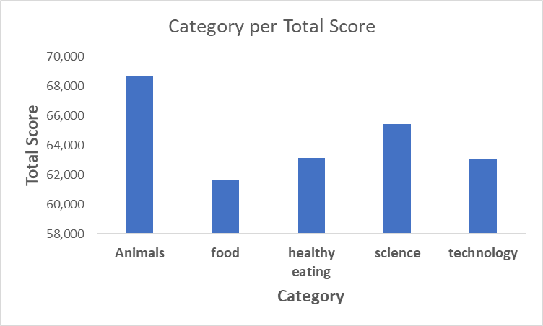
Graphical Representation of most popular category per to score

Slide 10

From the analysis done, The number of unique categories is 16.
The category with highest total score is 68624 which is Animals
The category with the lowest total score is 45751 which is Public speaking
The unique reaction types are: Disgust, Dislike, Scared, Interested, Peeking, Cherish, Hate, Indifferent, Super Love, Worried, Like, Heart, Want, Intrigued, Love, Adore.
Summary

Slide 11

Thank you!
ANY QUESTIONS?

